Slide 1
Development of an EKG risk score system applied for detection and quantification of myocardial damage
Pre-thesis presentation
Instructor: PhD. Le Quoc Trung
Student: Pham Khoi Nguyen – BEBEIU13051

Slide 2
INDEX
Myocardial Infarction
Electrocardiogram signal
Project objectives
Design and Implementation
Result and Validation
Conclusion and Discussion
REFERENCE

Slide 3

I. Myocardial Infarction
Myocardial Infarction is the leading cause of death worldwide
The World Heart Federation (WHF) estimates that the incidence of CAD in Vietnam in 2017 may reach 20%, ranking 4th in the world
Disease caused by insufficiency of blood supply to the heart’s tissue
Symptoms: Severe chest pain, Vomit, dizziness, shortness of breath

Slide 4
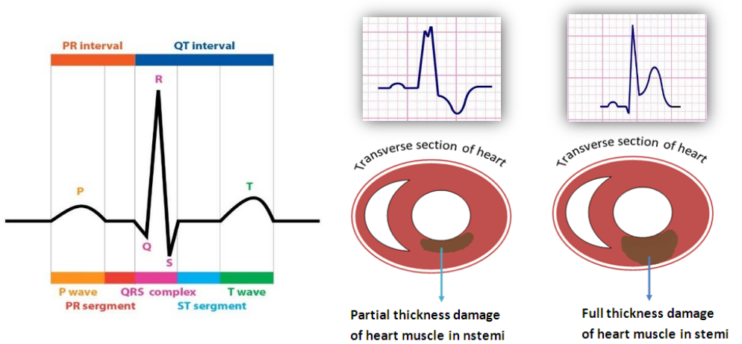
II. The electrocardiogram signal
Gold standard for approving patients to the Heart Disease Department
It measures the electrical activity of the heart during each consecutive heart beat
Detect MI: ST segment and T wave morphology

Slide 5

III. Project Objectives
Detection of ST Deviation (ST segment Elevation or Depression) in the EKG signal
Quantify the level of injury
Diagnose Myocardial Infarction using a risk score system

Slide 6
IV + V. Design and Implementation
Raw EKG signal
Normalization basing on energy
Baseline Wander Removal
De-trended Fluctuation Analysis
RR segmentation
Delineation
Estimating Threshold
Validation

Slide 7
Database Acquisition
ECG data is taken from 3 Physionet Databases:
Long-st Database:
dedicated for development and quantification of ischemia
European Database:
intended to be used for algorithms evaluation of ST and T-wave changes
ST-change Database
recorded during exercise stress tests and most of which exhibit transient ST deviation
Record range from 2 hours to 22 hours
Sampling rate of 250 Hz, 12 bit resolution
Total 94 records, 26 cases of STD, 38 cases of STE

Slide 8
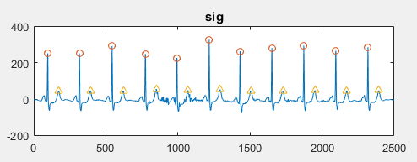
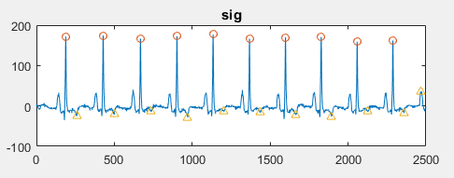
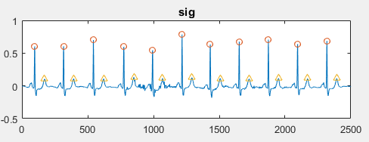
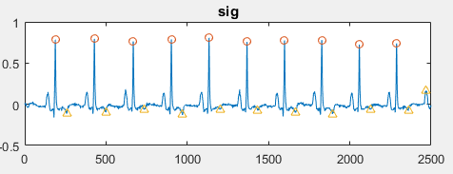
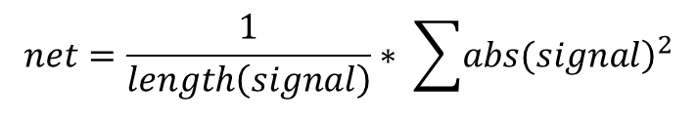
Normalization
% NORMALIZATION CODES---------------------
sig1_raw = sig1_raw - mean(sig1_raw);
L = length(sig1_raw);
Ex = 1/L * sum(abs(sig1_raw).^2);
sig1_raw = sig1_raw / Ex;
% NORMALIZA THE SIGNAL FROM 0 TO 1
sig1 = sig1 + abs(min(sig1));
sig1 = sig1 / max(sig1);
Scale down the signal with its energy, make the signal comparable
$$net=\frac{1}{length\left(signal\right)}∗ \sum{{\left.abs(signal\right)}^{2}}$$

Slide 9
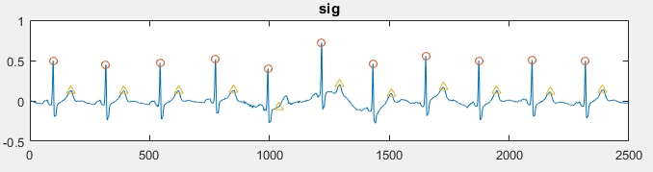
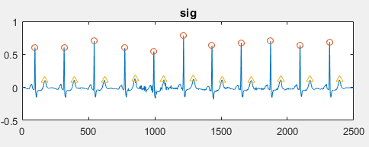
Baseline wander removal using Wavelet Transform
Using Discrete Wavelet Transform (DWT)
‘db11’ mother wavelet, 9 level of decomposition
The approximation coefficient at level 9 is the baseline wander
Before
% BASELINE REMOVE
[approx, detail] = wavelet_decompose(sig1_raw, 9, 'db11');
sig1 = sig1_raw - approx(:,9);
After

Slide 10
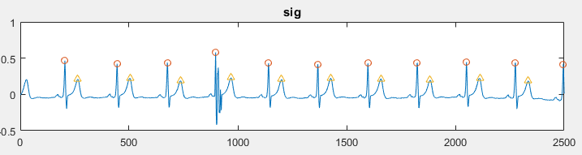
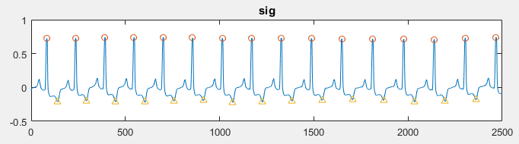
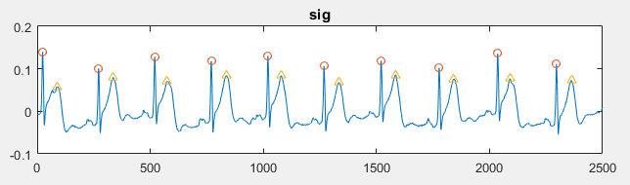
R peaks detection and T wave detection
Self – constructed algorithm for R peak and T wave Detection (33 lines of code)
Algorithm: filter 10-25 Hz, scale from 0 to 1, power 12, peak detection, validate R peak
T peak is the max of the absolute value of the segment of from 0.2 RR to 0.6 RR

Slide 11
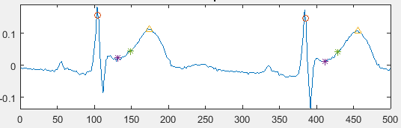
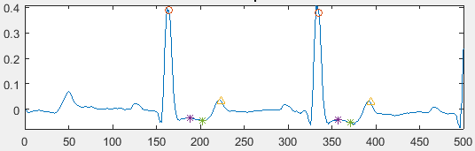
ST segment detection
The segment defined from 0.4 RT to 0.65 RT

Slide 12
Morphological features extraction
Name | Calculation | Threshold | Score
ST deviation | Area between ST and isoelectric line / length(ST) | > 40 or < -20 | +1
ST slope | tan(ST line) | >6 or < -4 | +1
T amp | (T - iso) / (R - iso) * 100 | > 0.8 or < 0 | +1

Slide 13
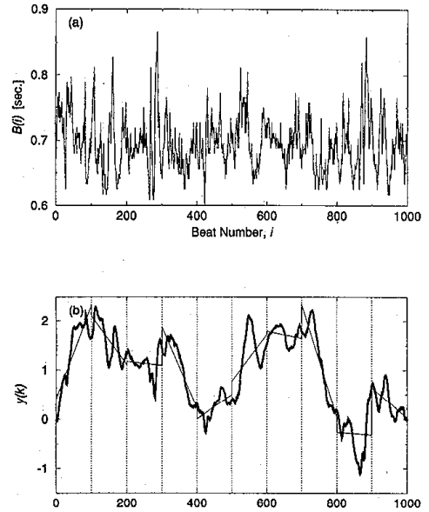
De-trended Fluctuation Analysis: an overview
Measures the degree of fluctuation within a signal without consider its trend
Large value of DFA corresponds to more complexity of a system
Many researchers have reported the relationship between DFA and MI
Normal subject: DFA < 1
MI subject: DFA > 1
Matlab supported code:
dfa = DetrendedFluctuation(data);

Slide 14
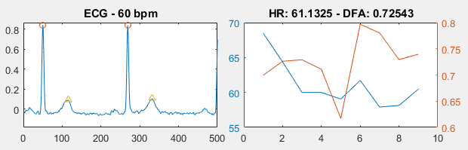
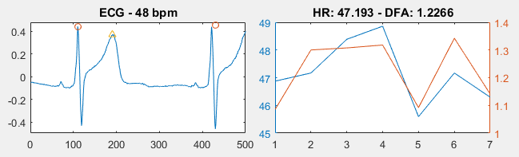
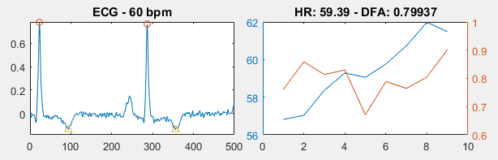
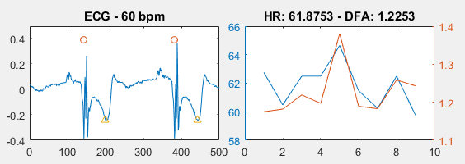
De-trended Fluctuation Analysis
Statement: DFA > 1, then score = score + 1;
Normal patient
ST Elevation MI
T inverted Ischemia
ST Depression MI

Slide 15
Result: risk score
A database of 31,000+ entries created, each entry has 4 features: ST slope, ST deviation, T amp and DFA value
Risk score is calibrated, max is 4 and min is 0
 |  | Score | Description | Disease types
Valid | Normal | 0 | Normal EKG | Healthy
 | Caution | 1 | Small ST deviation or T inversion | Postures changes or anxiety
 | Risk | 2 | Transient ST deviation with DFA confirmation or with T inversion | Suspected of myocardial injury or ischemia
 | Danger 1 | 3 | Transient ST deviation, ST slope with DFA comfirmation | Diagnosis with ST elevation myocardial infarction
 | Danger 2 | 4 | Transient ST deviation, ST slope with DFA confirmation and T wave inversion | Diagnosis with ST depression myocardial infarction

Slide 16
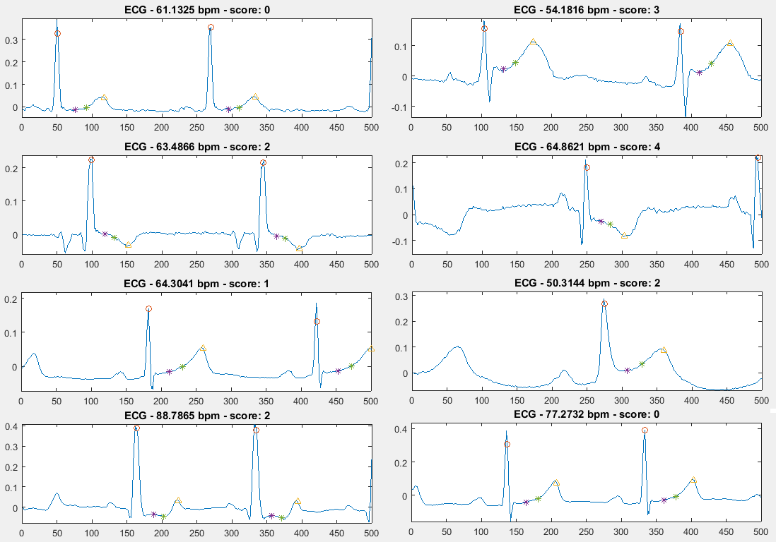
Validation

Slide 17
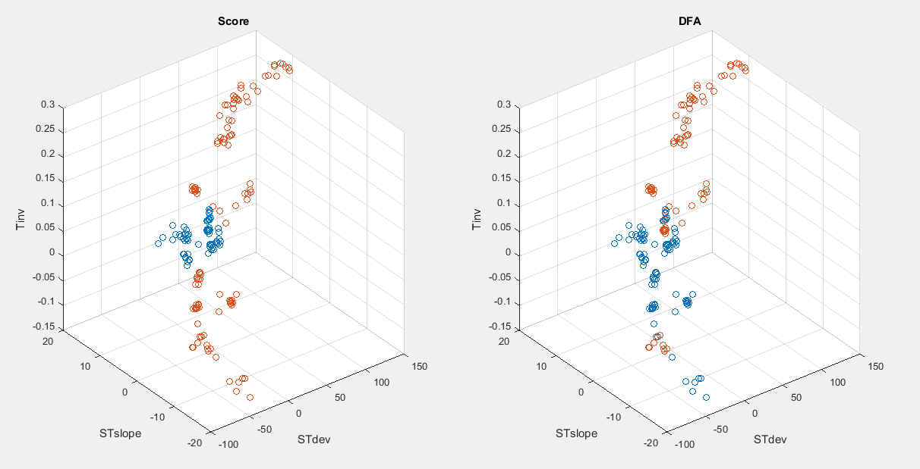
Result: DFA value
potential value for detection of transient ST deviation
Scatter plot of 180 data entries computed from the European database

Slide 18
Result: DFA value
Analysis is carried out from all records of the 3 databases. The sensitivity and specificity is described below:
 |  | Number of cases | Sensitivity | Specificity
DB | European | 12523 | 0.8594 | 0.6539
 | Long ST | 15155 | 0.9166 | 0.7022
 | ST changes | 4263 | 0.8108 | 0.5395

Slide 19
VI. Conclusion and Discussion
In order to obtain good result using EKG, QRS detection need to be extremely precise
DFA is found to be valuable in detection of transient Myocardial Infarction
The DFA higher than 1 indicate transient ST deviation
Sensitivity is potentially good, but specificity is still poor
More features should be extracted in order to reliably detect Myocardial Infarction using EKG signal

Slide 20
VI. Conclusion and Discussion
Short term plan:
Working with doctors to validate the accuracy of the risk score
Implement the system to an online platform
Building android, iOS and desktop applications for this algorithm
Long term plan:
Extracting more features for further analysis
Research on the technique that discriminate ST segment myocardial infarction from other diseases

Slide 21
VII. References
Woo MA, Stevenson WG, Moser DK, Trelease RB, Harper RH (1992) Patterns of beat-to-beat heart rate variability in advanced heart failure. Am Heart J 123:704–707
Wharton JM, Coleman RE, Strauss HC (1992) The role of the autonomic nervous system in sudden cardiac death. Trends Cardiovasc Med 2:65–71
Wilson PW, Evans JC (1993) Coronary artery prediction. Am J Hypertens 6:309S–313S
Rothschild M, Rothschild A, Pfeifer M (1988) Temporary decrease in cardiac parasympathetic tone after acute myocardial infarction. Am J Cardiol 18:637–639
Rossinin J, Vitasalo M, Partanen J et al (1997) Effects of acute alcohol ingestion on heart rate variability in patients with documented coronary artery disease and stable angina pectoris. Am J Cardiol 79:487–491

Slide 22
THANK YOU

